Slide 1
Urbanization
Does ‘progress’ benefit society?

Slide 2
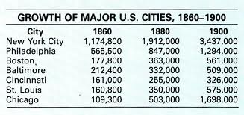
Urbanization
The rapid growth of cities
During the late 19th century, America saw Urbanization across the country

Slide 3
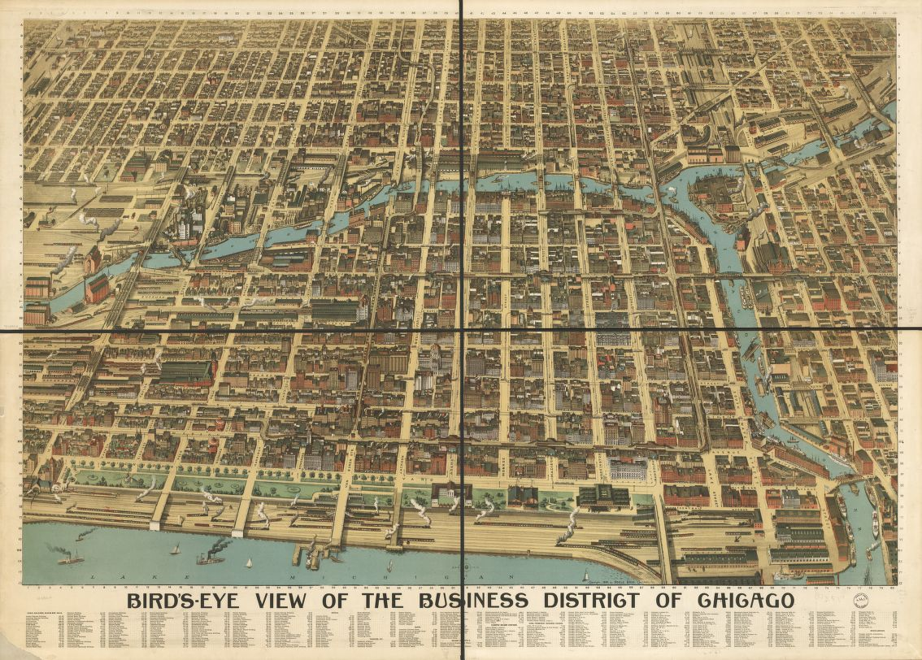

Slide 4
Why Cities?
Factories need workers
Unskilled workers
Cheap living
Convenient
Near work
For immigrants especially, this was important because they could form communities with people who shared their culture

Slide 5
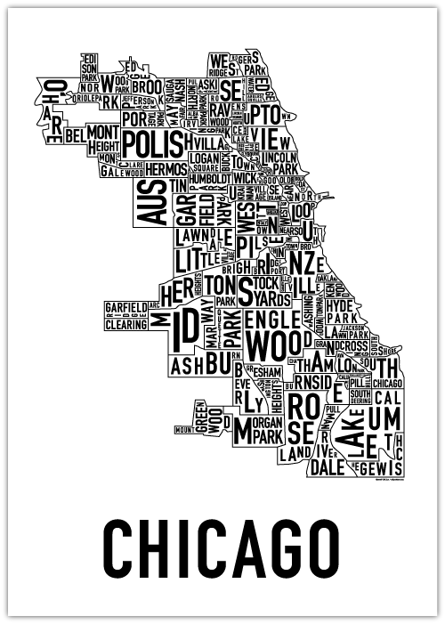

Slide 6
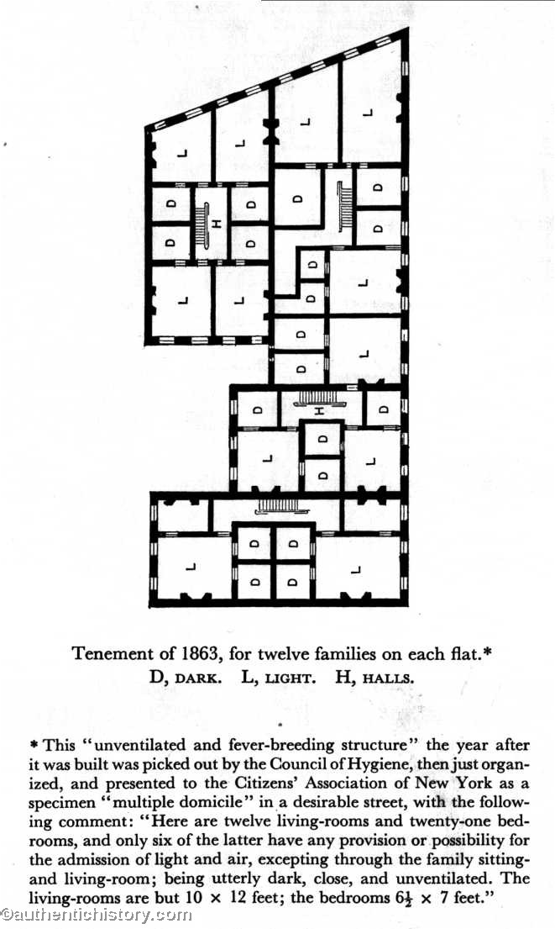

Slide 7
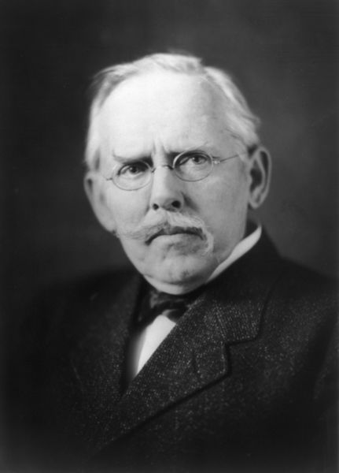
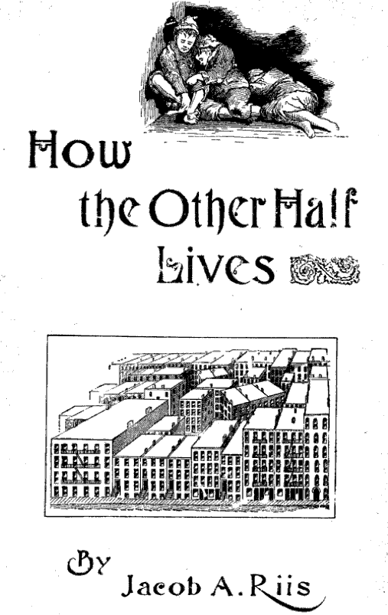
Jacob Riis: “How the Other Half Lives”
Photographed and described poverty, disease, and crime that affect immigrant neighborhood in New York City.

Slide 8
Directions
Create a caption for each of the photographs shown
Include:
Who do you think is in the photo?
Where are they?
What are they doing?
When was the photo taken?

Slide 9
